Slide 7
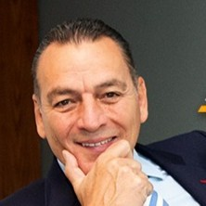
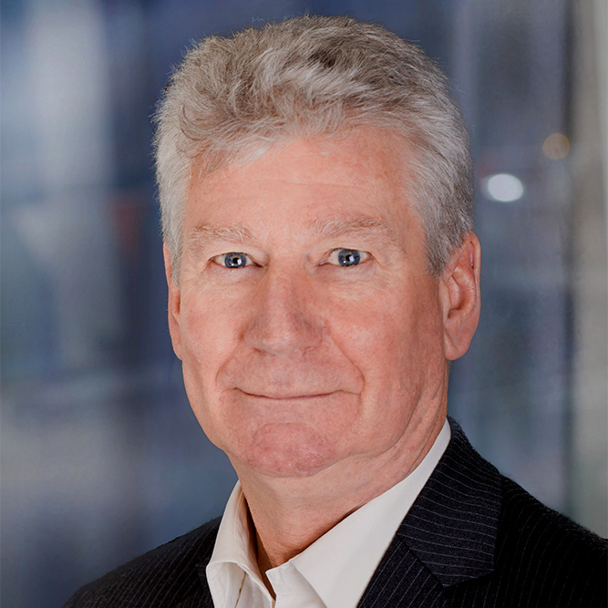
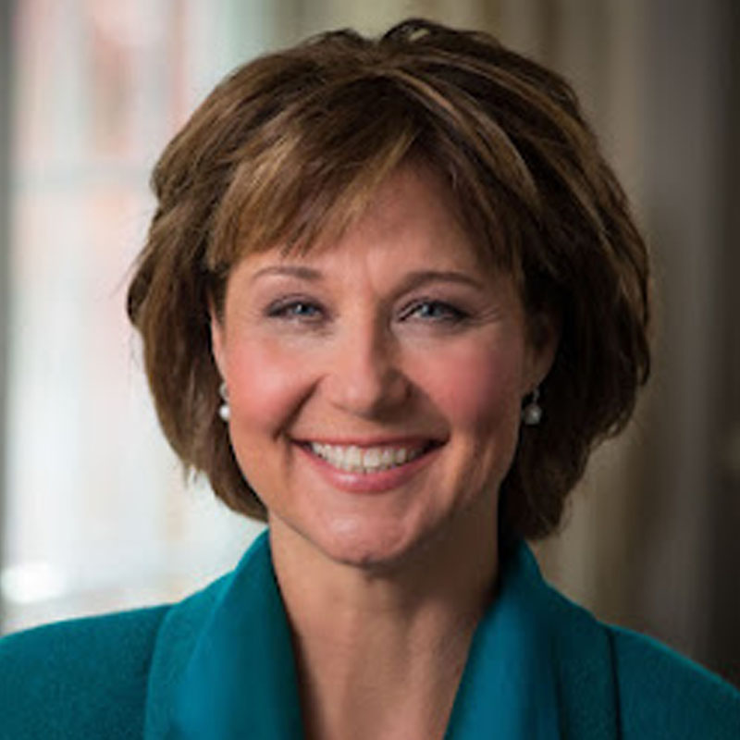
The Ambassadors — Perspectives on Canada’s Key Relationships
Panellists:
Moderator:
Pierre Alarie Regional Chair, ATCO Latin America, Former Canadian Ambassador to Mexico
Stewart Beck Former Canadian High Commissioner to India and Advisory Board Member, Canadian Leadership Congress
Christy Clark Former Premier, British Columbia

Slide 8
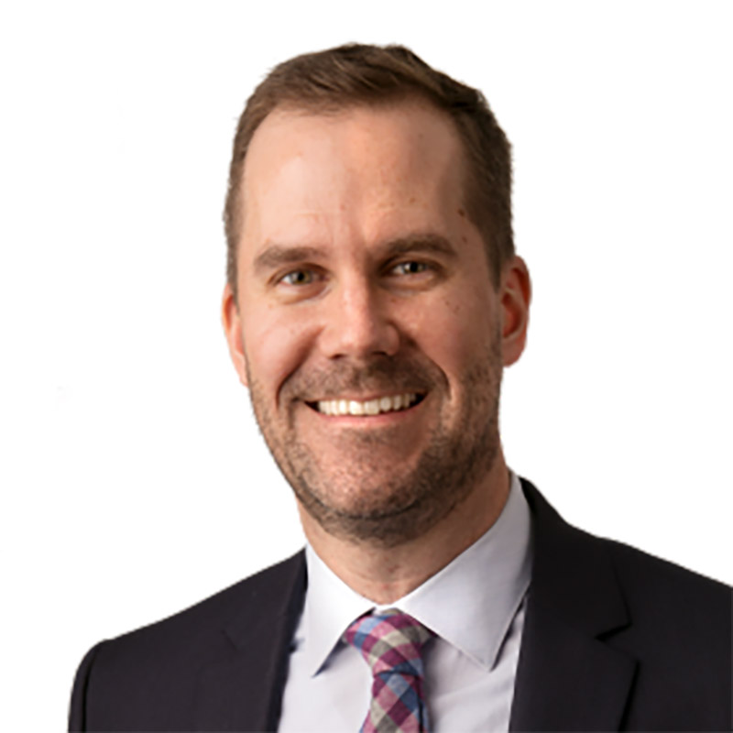
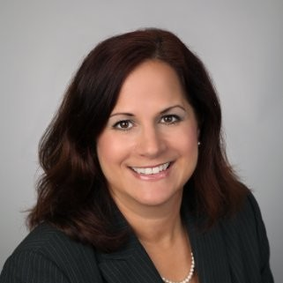
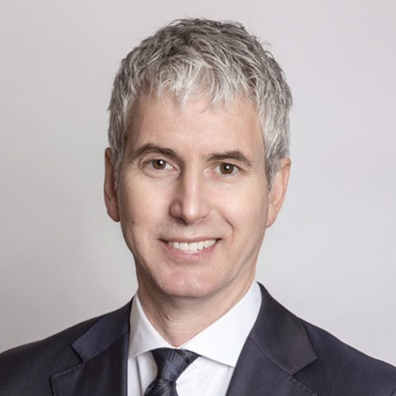
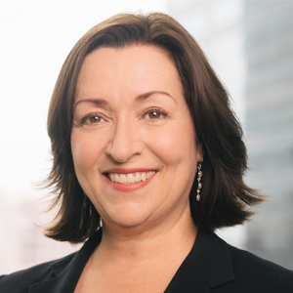
Thriving Through Disruption — Lessons, Challenges, and Opportunities in Today’s Markets
Panellists:
Moderator:
Jason Campbell Principal, Investment Consulting, Eckler
Katheen Pabla Director, Public Markets, CAAT Pension Plan
David Ross Senior Managing Director, Total Portfolio Management, OPTrust
Dr. Marlene Puffer Former CIO, AIMCo, and Advisory Board Member, Canadian Leadership Congress

Slide 9
WORKSHOP Q&A
QUESTION
Have you had to become more reactive in your investment approach over the last 6 months? If yes, how have you approached decision making with your teams?

Slide 10
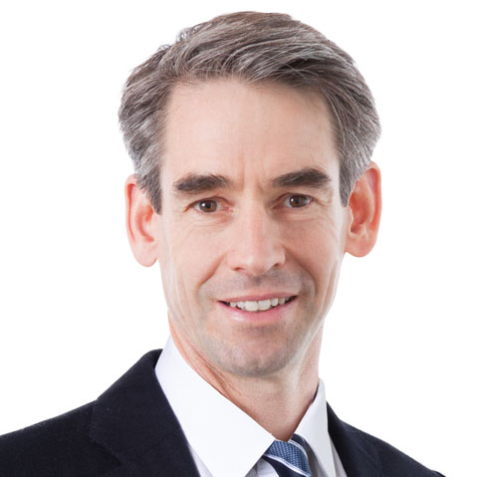
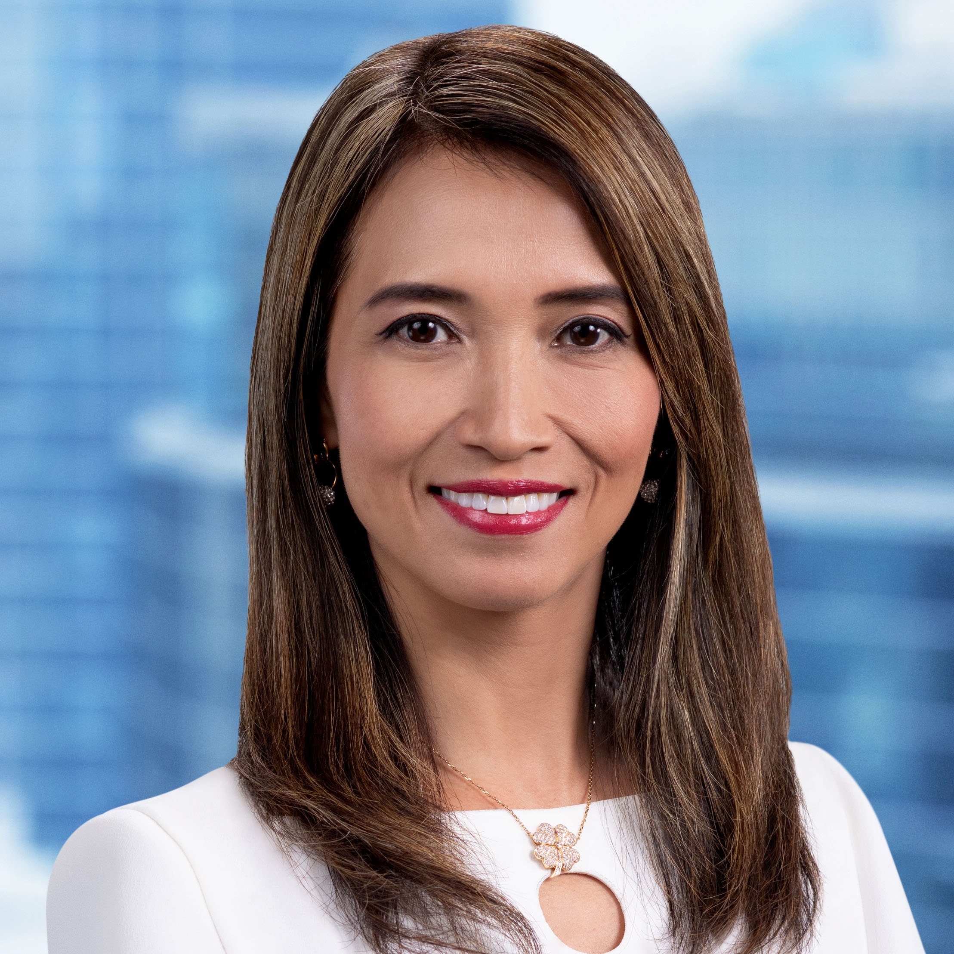
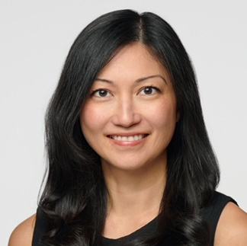
Navigating Opportunity: Assessing Emerging Markets
Presenters:
Moderator:
Dominic Bokor-Ingram Senior Portfolio Manager, Emerging and Frontier Markets, Fiera Capital
Vivian Lin Thurston, CFA Partner, Portfolio Manager, William Blair Investment Management
Candy Wong Portfolio Manager, International Strategies,
Manitoba Civil Service Superannuation

Slide 11
WORKSHOP Q&A
QUESTION
Is the higher volatility in emerging markets justified by the long-term return prospects?

Slide 13
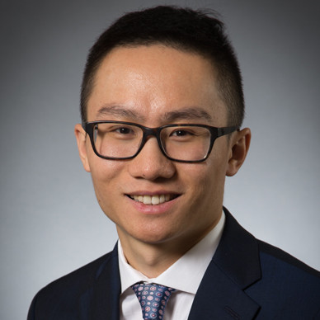
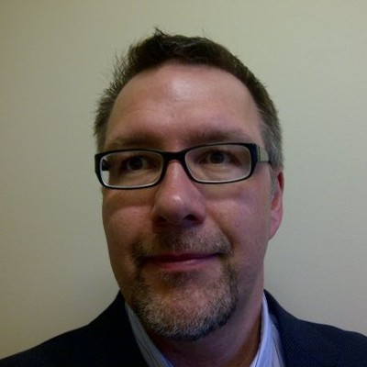
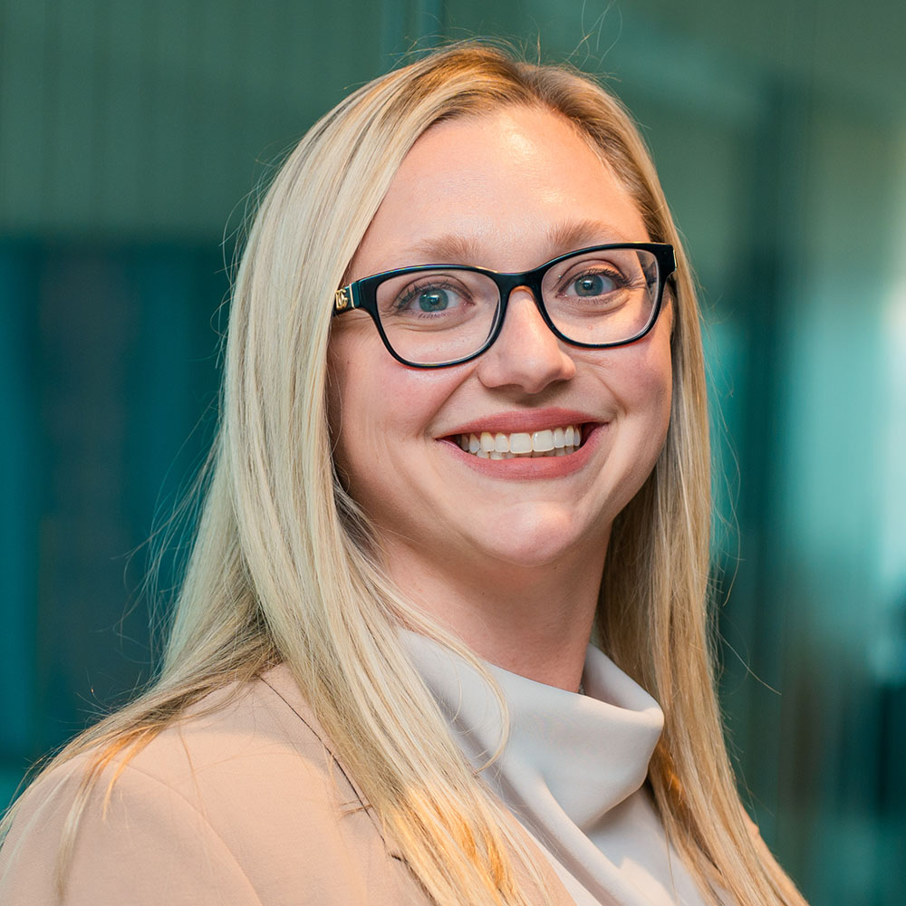
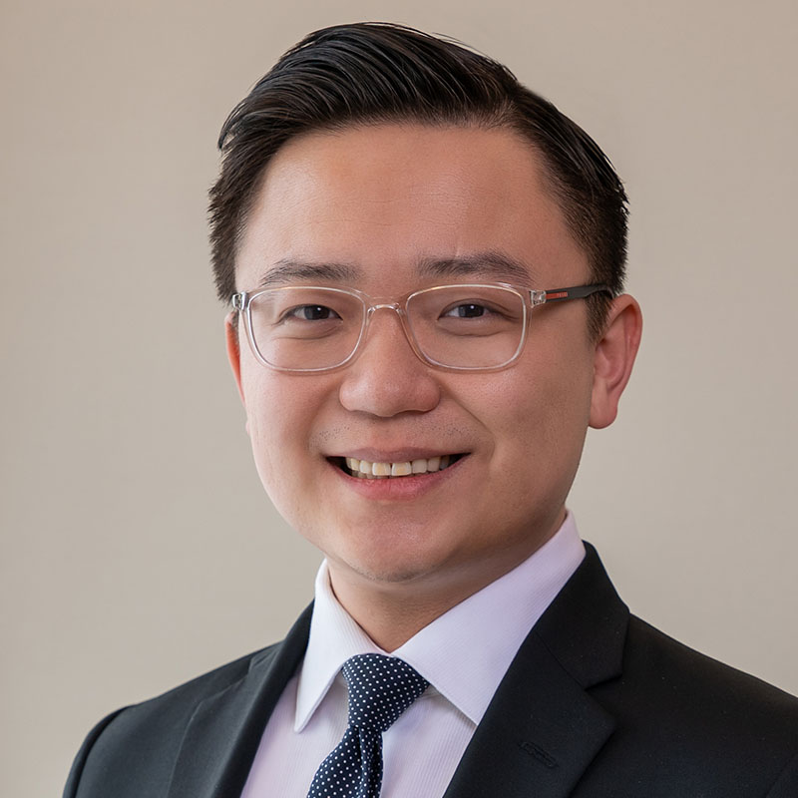
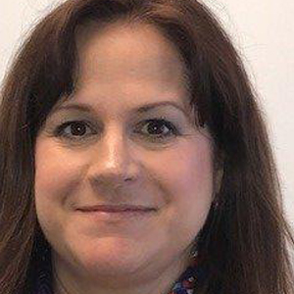
The Future of Net Zero — Adaptive Strategies in Challenging Times
Panellists:
Moderator:
Jeff Chan Director, ESG Investing, Canada Post Pension Plan
Richard Iwuc Portfolio Manager, University of Alberta
Caroline Kidnie Vice-president of Investment and Climate Risk, OMERS
Yi Shi Client Portfolio Manager and Engagement Specialist, Pictet Asset Management
Katheen Pabla Director, Public Markets, CAAT Pension Plan

Slide 14
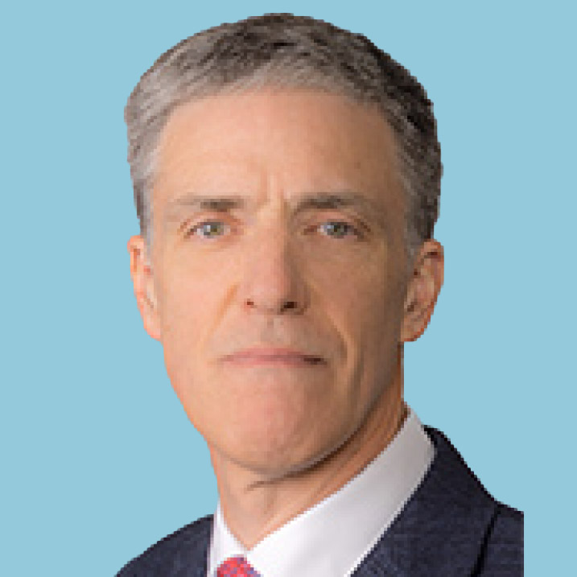
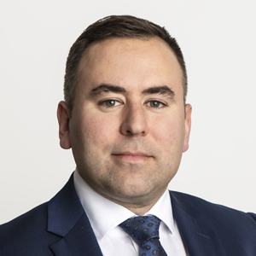
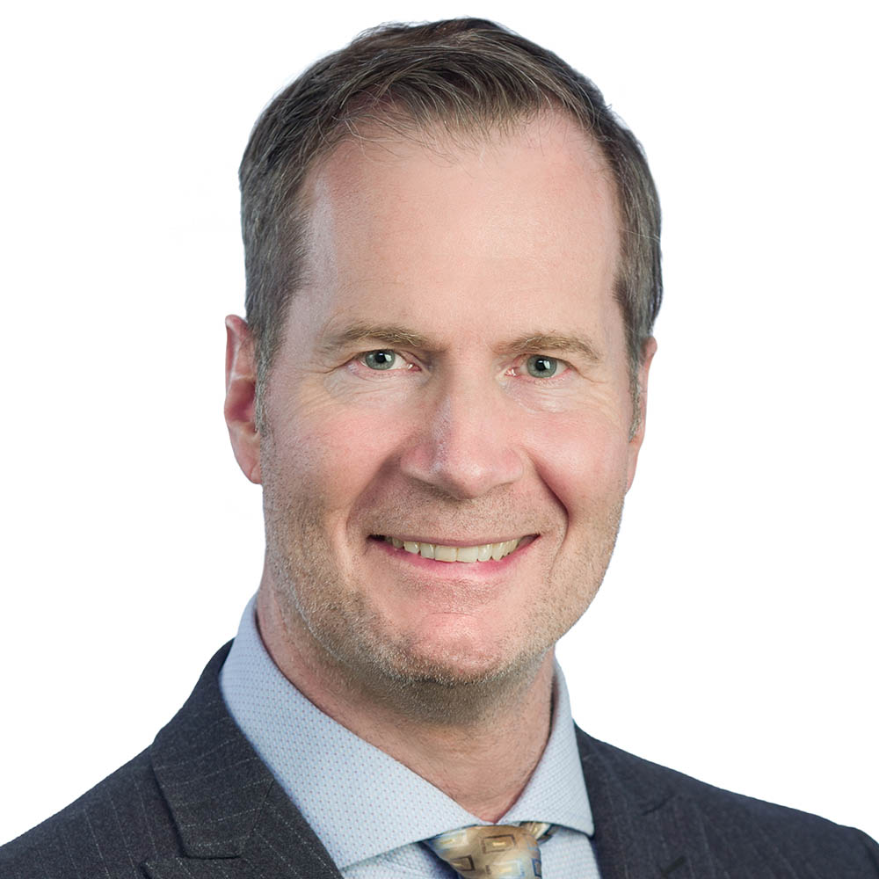
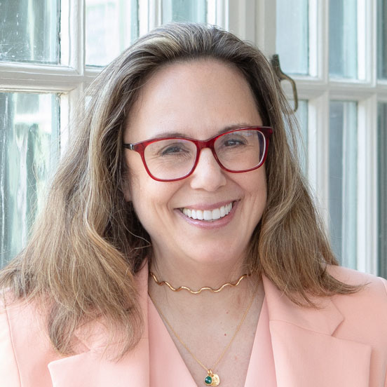
Looking Beyond the Hype — Finding Opportunities in Transformative Sectors
Panellists:
Moderator:
Jonathan Curtis Executive Vice-president and CIO, Franklin Equity Group (FEG)
Justin Lord Senior Executive Managing Director and Global Head of Public Markets, AIMCo
Peter Orcheson Director, Total Fund Management, PNYX Investments Ltd.
Caroline Cakebread Co-founder,
Canadian Leadership Congress

Slide 15
WORKSHOP Q&A
QUESTION
In 10 years, what sector do you think will dominate the top of the index? Why?

Slide 17
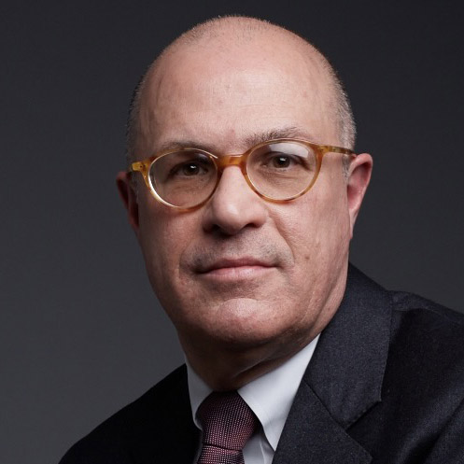
Shaping Tomorrow: The Future of Global Markets
Presenter:
Moderator:
J. Christopher Giancarlo Former Chairman of the U.S. Commodity Futures Trading Commission
Dr. Marlene Puffer Former CIO, AIMCo, and Advisory Board Member, Canadian Leadership Congress

Slide 18
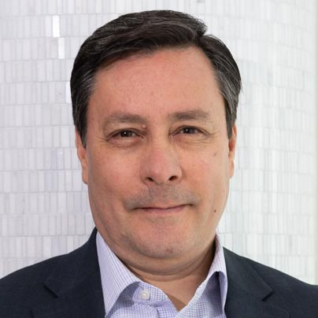
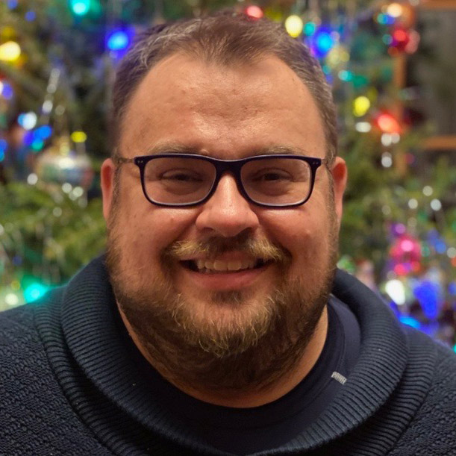
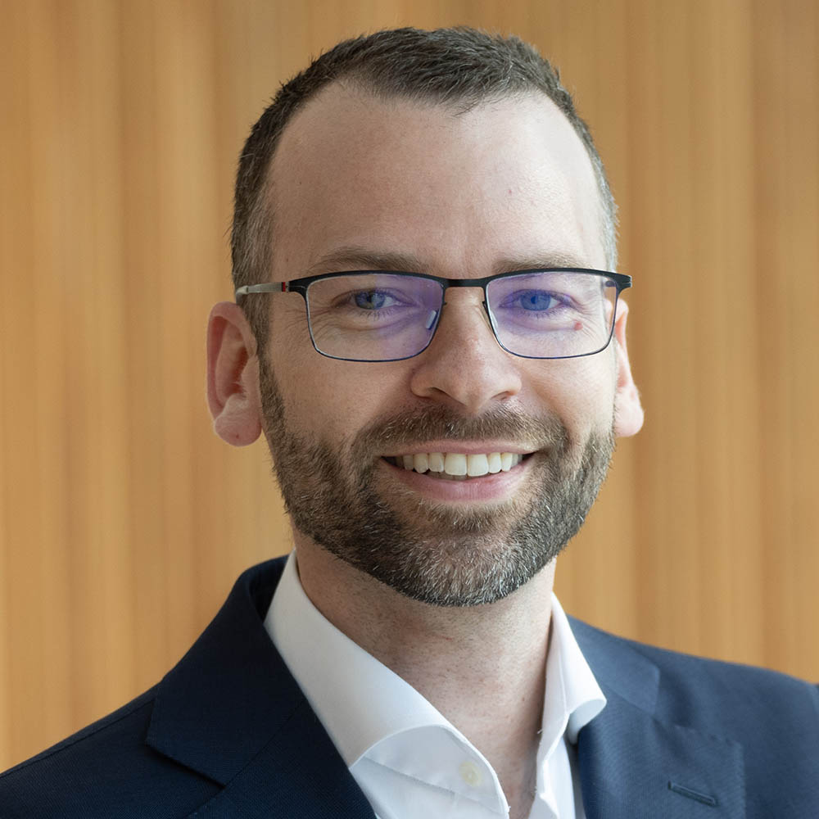
New Approaches to Infrastructure
Panellists:
Moderator:
Federico Cervantes Partner and Head of the Investment Consulting Practice for Central Canada, Aon
Filip Ksiazkiewicz Senior Portfolio Manager, Private Assets, Telus
Alex Side Managing Director, Infrastructure, IMCO
Loren Francis Vice-president and Principal, Highview Financial Group

Slide 20
CONGRESSIONAL HUDDLE
QUESTION
Given the current geopolitical environment, should pension plans be investing more in Canada?

Slide 21
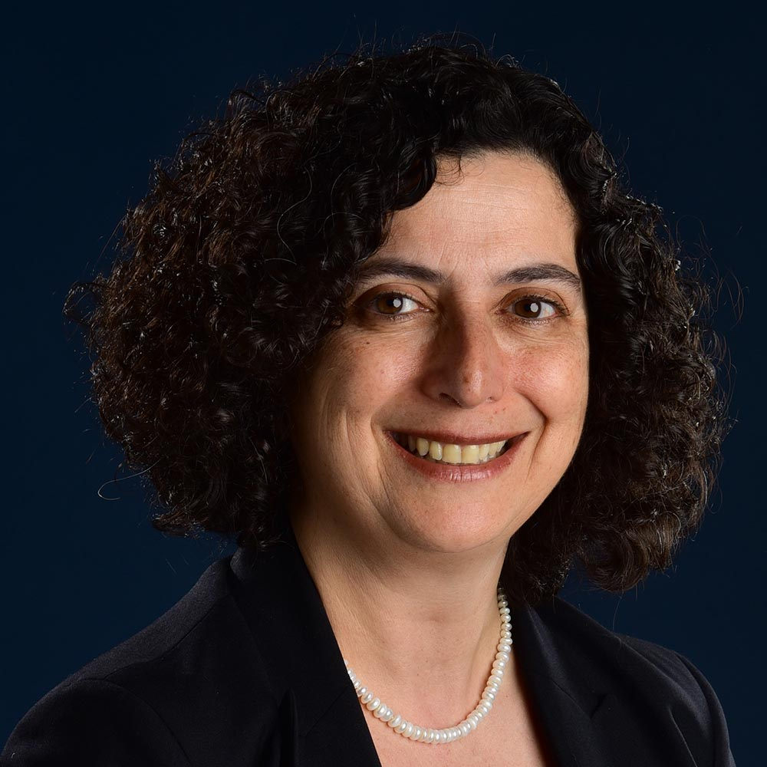
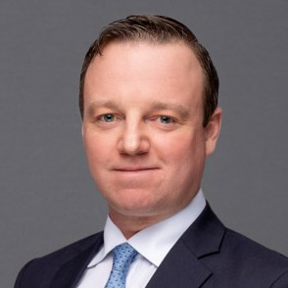
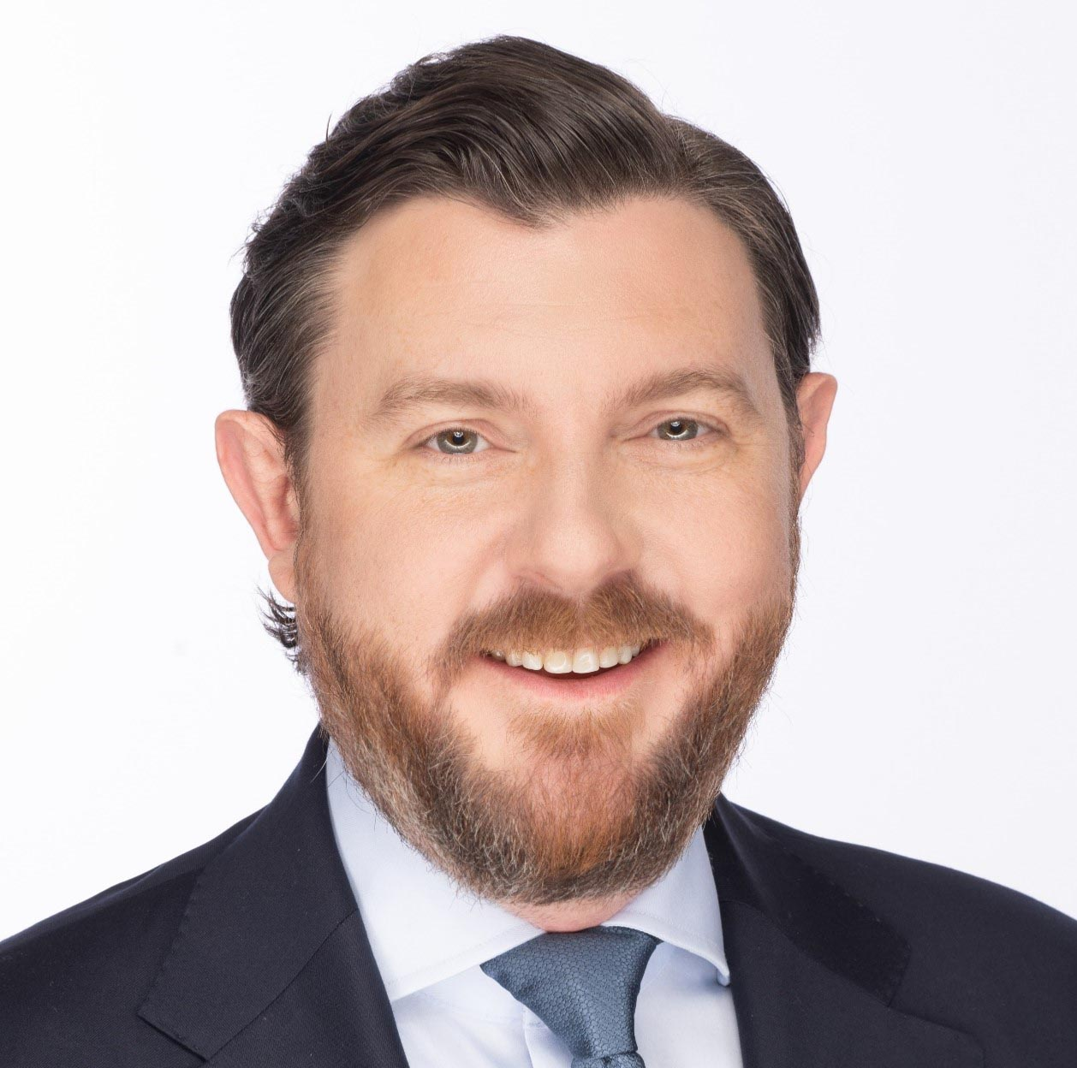
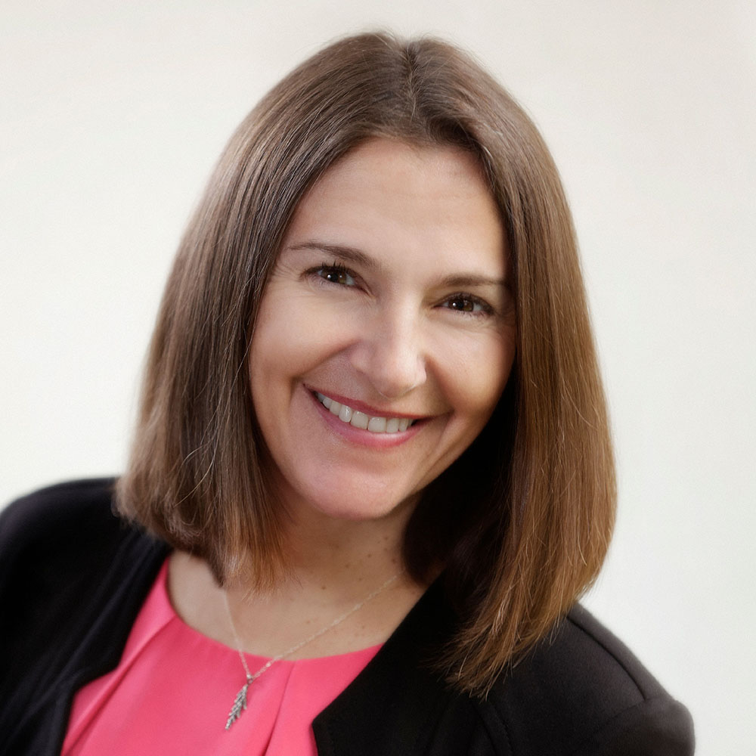
Credit in a Changing World
Panellists:
Moderator:
Serra Erdogmus CIO, Canadian Medical Protective Association
Ryan Kuruliak Senior Vice-president and Practice Leader, Investment HUB International
Aaron Young Vice-president and Client Portfolio Manager, CIBC Asset Management
Josée Mondoux Pension Fund Investment Committee, University of Ottawa

Slide 22
WORKSHOP Q&A
QUESTION
Over the next 1-3 years, are you looking to increase/decrease/keep the same your allocation to Public Credit? Private Credit? Why?

Slide 27
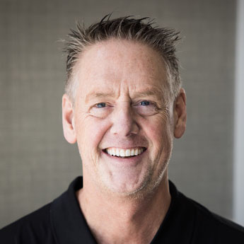
Keynote Fireside Chat
Presenter:
Moderator:
Michael Buhr Executive Director, C100
Christy Clark Former Premier, British Columbia

Slide 28
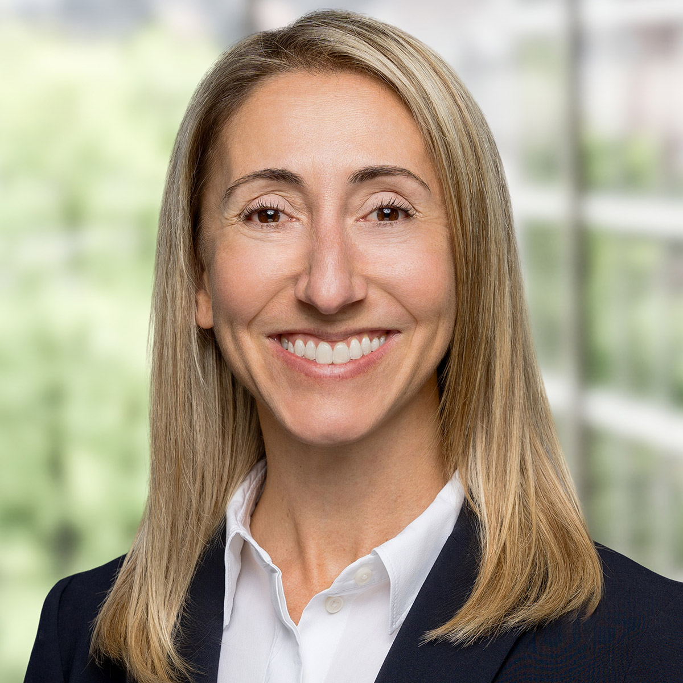
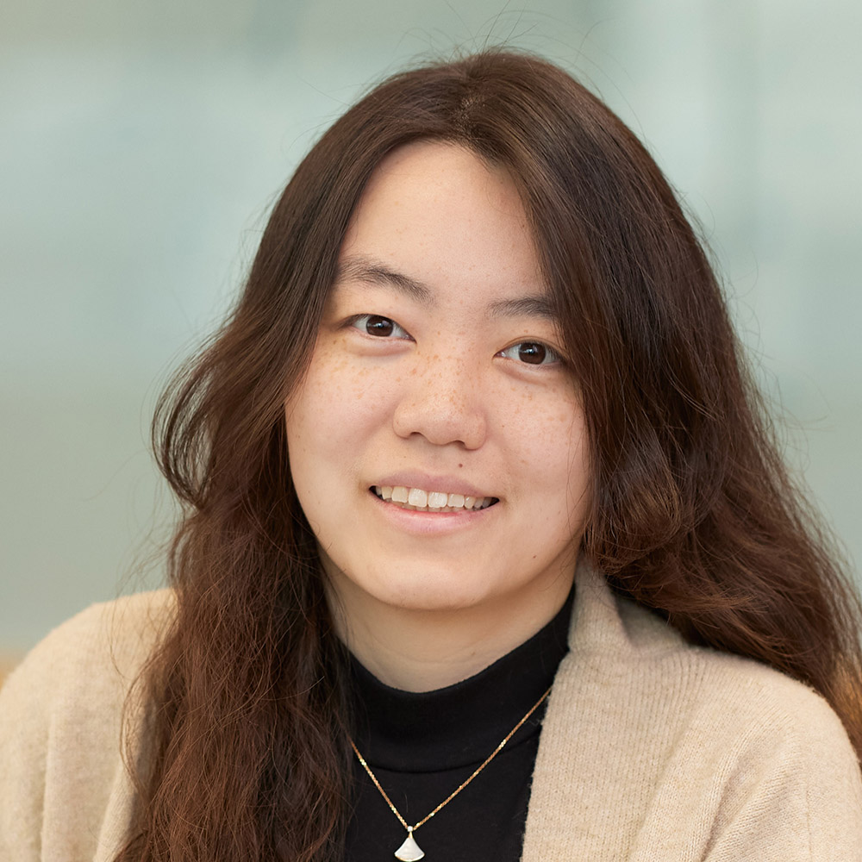
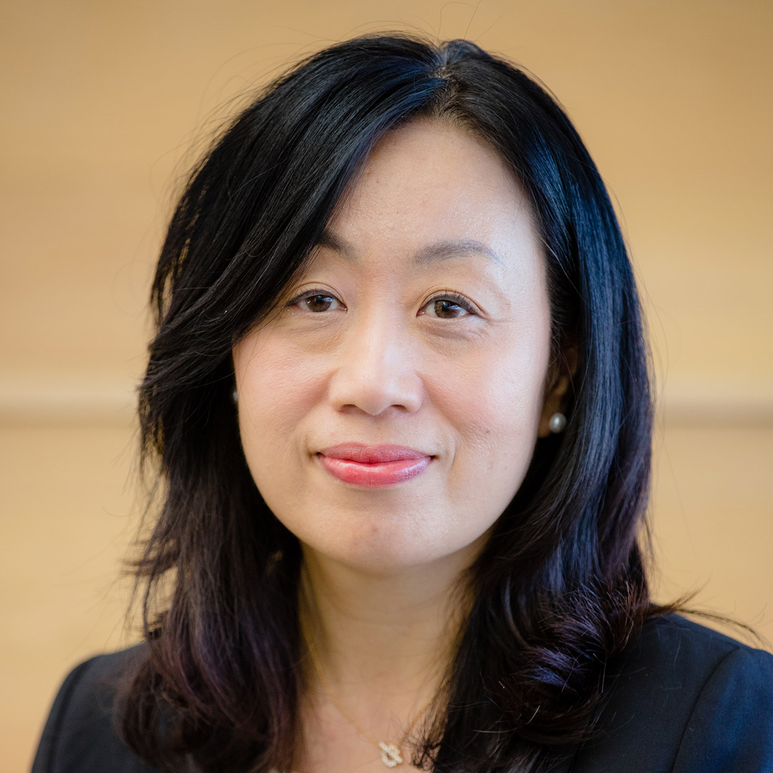
Private Markets at a Crossroads — Challenges and Strategies
Panellists:
Moderator:
Jason Campbell Principal, Investment Consulting, Eckler
Jane Segal Managing Director, Wittington Investments
Shan Shan Investment Manager, Baillie Gifford
Tracey Wong Vice-president, Sales and Consultant Relations, Fidelity Canada Institutional

Slide 29
WORKSHOP Q&A
QUESTION
What’s your biggest concern with your current private markets portfolio - liquidity risk, vintage year concentration, fee drag or GP alignment?”

Slide 31
CONGRESSIONAL HUDDLE
QUESTION
How has geopolitical tension impacted your investment decision making in the last 6 months?

Slide 32
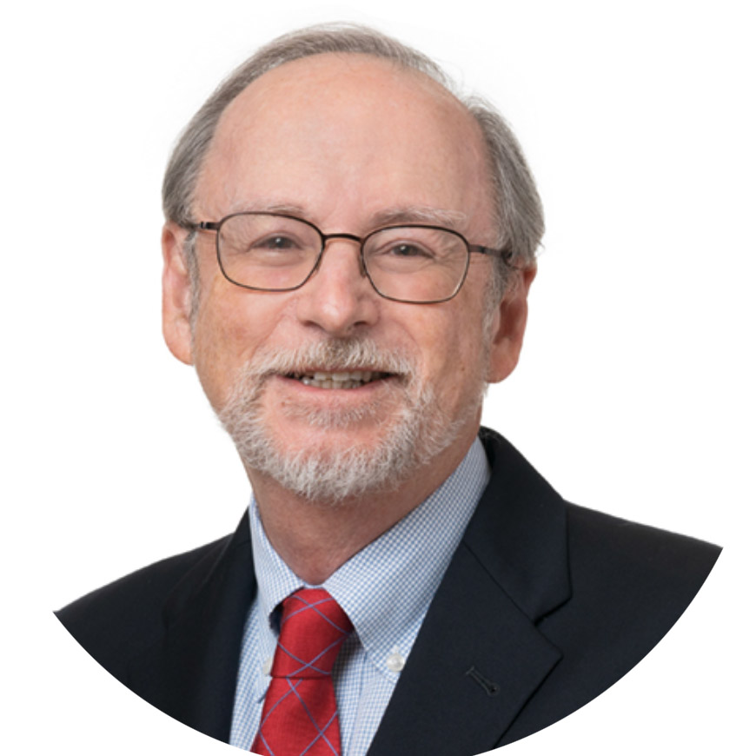
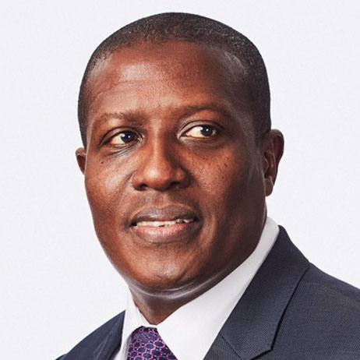
U.S. Policy and the Future of International Finance
Presenters:
Moderator:
Steven B. Kamin Senior Fellow, American Enterprise Institute (AEI), and Former Director, International Finance, U.S. Federal Reserve Board
Millan Mulraine Chief Economist, Ontario Teachers’ Pension Plan
Dr. Marlene Puffer Former CIO, AIMCo, and Advisory Board Member, Canadian Leadership Congress

